Slide 1
What Impact a University’s Enrollment Rate, First-year Retention Rate, and Graduation Rate?
By Qi Sun
Wen Chen
Yunxiang Wang

Slide 2
Table of Contents
Introduction
1. It is important for universities to plan effective strategies on student recruitment.
2. The purpose of this study is to examine factors that impact and predict higher education student enrollment rate, first-year retention rate, and graduation rate.
3. Potential stakeholders in this study include but are not limited to university leaders and deans, and other administrators who are affiliated with the institution.
Graduation Rate
Introduction
Question1: Does university rank( or Overall Score ) affect graduation rate?
Question2: Is there a difference between graduation rates of public universities and the rates of private universities?
Data Collection
Student Enrollment Rate
First-Year Retention Rate
Data Acquisition
Data Preparation
Introduction and Literature Reviews
Exploratory Data Analysis
Question 1. What statistically significant association exists between independent variables and the enrollment rate?
Questions 2: To what extent does independent variables predict the enrollment rate?
Conclusion
Introduction
Exploratory Data Analysis
Question 1: Private or Public, whose retention rate is higher?
Question 2: How financial resources and student cost affect retention rate?
Question 3: Build a prediction model for retention rate.
Conclusion
Questions 3: What is the relationship between student/faculty ratio and rank?
Question 4: Can the SAT be used as an indicator of the graduation rate?
Question 5: What is the impact of Cost on school graduation rates?
Question 6: With the above analysis, can we do the best graduation rate regression of each school?
Conclusion

Slide 3
Data Acquisition
csv
U.S. News National University ranking 2019 data
There are a total of 229 observations with 28 columns in this dataset.
API
Use API to access the College Scorecard Data
The fields of school name, ID, state, ACT score midpoint, SAT score average, and cost of attendance were searched.
There are 7175 observations (colleges) in total.
csv
Student financial aid data from the Integrated Postsecondary Education Data System (IPEDS)
There are 6394 colleges and 647 columns in this dataset.
The columns of the unique institution ID(UNITID) and the total amount of scholarship aid were used.
csv
Data of Admission considerations, applications, admissions, and enrollees from IPEDS
There are 2075 observations with 68 columns in this dataset.
The total number of admission and enrollment were used.

Slide 4
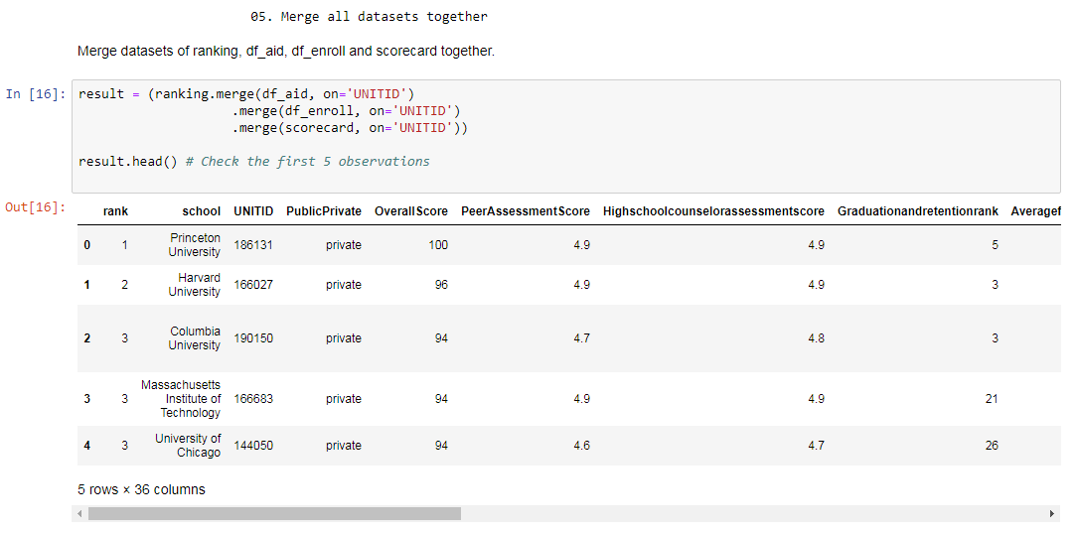

Slide 5
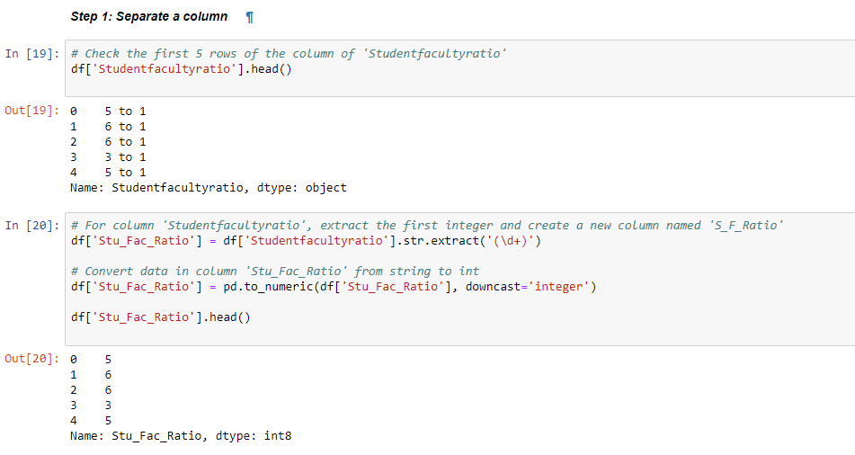

Slide 6
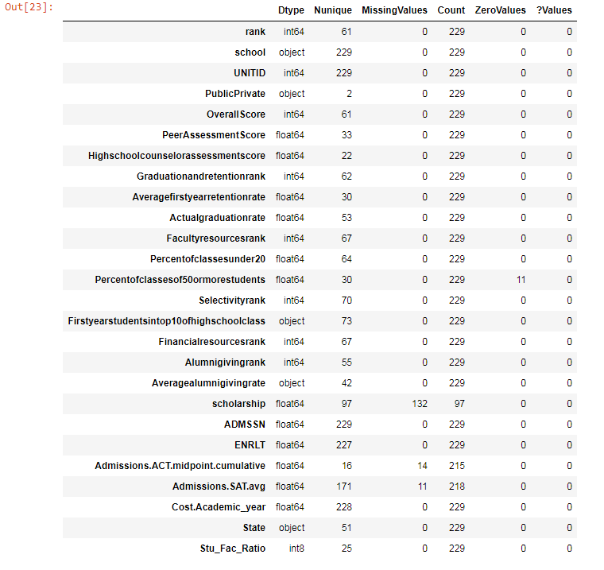

Slide 7
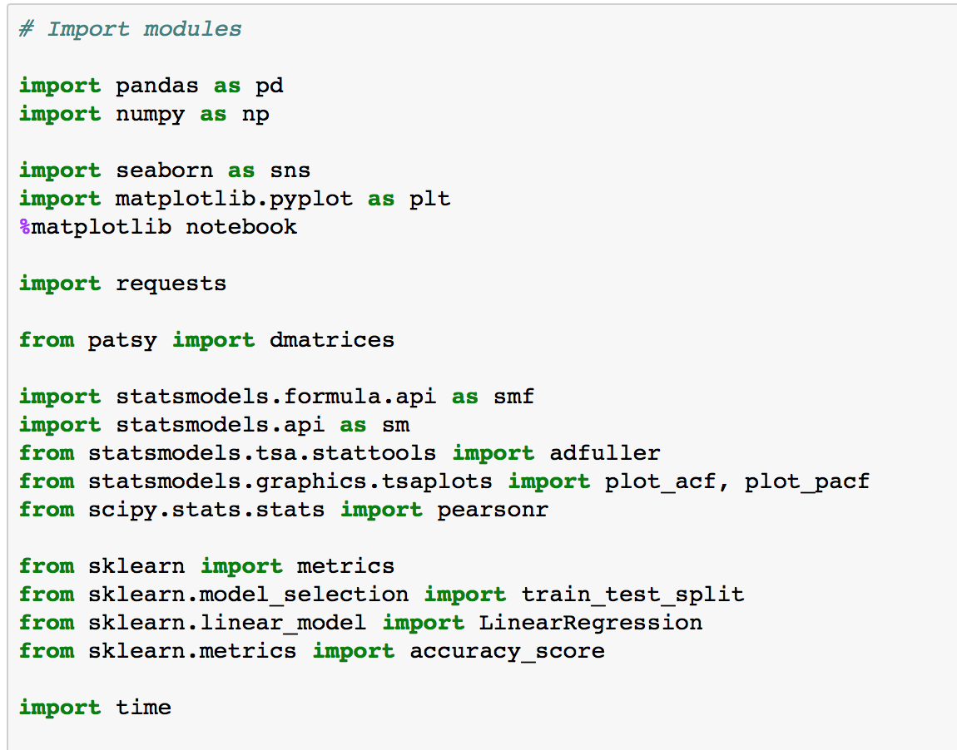
Analyze data - Import modules

Slide 8
Student Enrollment Rate (Yield Rate)
Literature Reviews
Keling (2007) stated that the most influential factor that students will evaluate in selecting their choice of institution was reputation of the institution.
From the article of “National Universities Where Most Accepted Students Enroll” published on U.S. News website, Brigham Young University (Provo), ranked the third highest rate, has a 80.7% enrollment rate, and Yeshiva university ranked 21st has a 53% enrollment rate. It seems that for some universities the ranking did not weaken their enrollment rates.
Research Questions
1.What statistically significant association exists between independent variables and the enrollment rate?
2. To what extent does independent variables predict the enrollment rate?
Variables
There are 5 independent variables, they are:
OverallScore: the overall score for the ranking, range from 1 to 100, numerical variable.
Percentofclassesunder20: percent of class under 20 students in the university, numerical variable.
Stu_Fac_Ratio: how many students for every one teacher, numerical variable.
Cost.Academic_year: the average annual total cost of attendance (including tuition and fees, books and supplies, and living expenses), numerical variable.
PublicPrivate: it indicates the type of university, public or private, categorical variable.
Dependent variable: enroll_rate = enrollment number/admission number, numerical variable

Slide 9
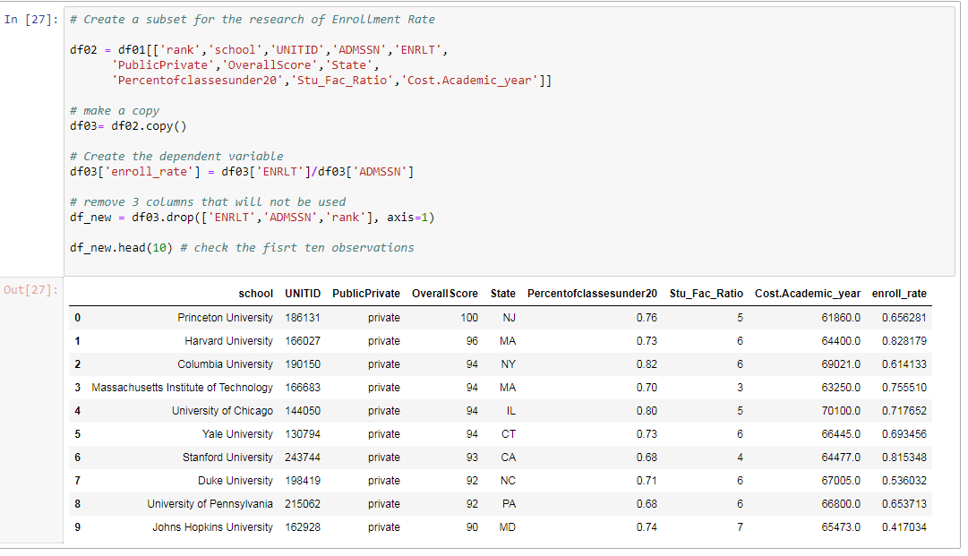

Slide 10
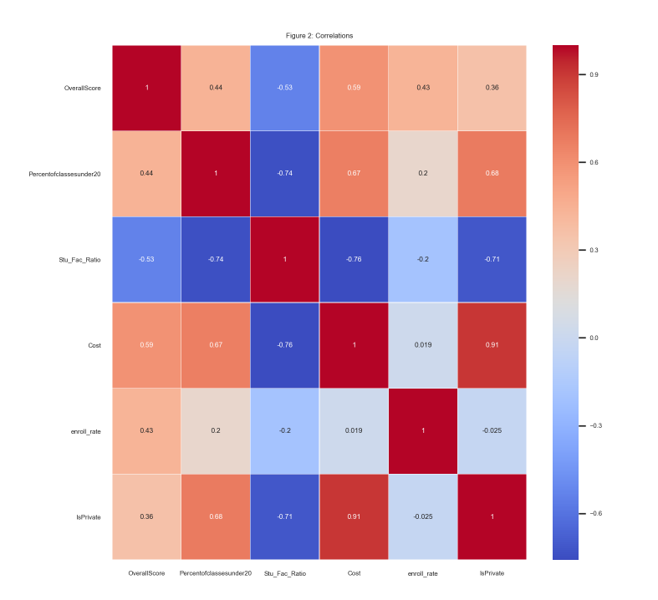


Slide 11
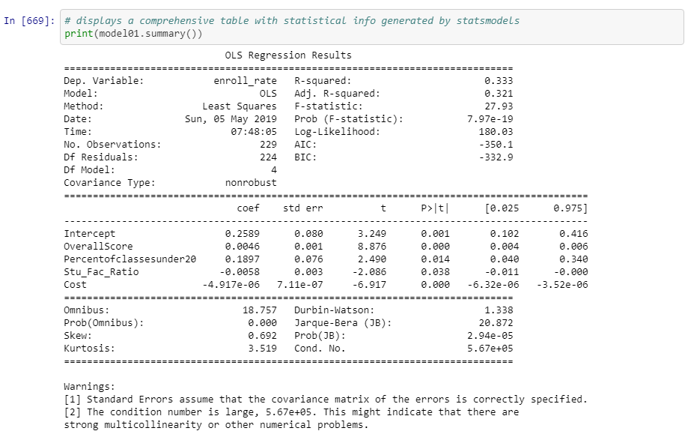

Research Question 1. What statistically significant association exists between independent variables and the enrollment rate?
Null hypothesis: There is no relationship between independent variables and the enrollment rate (and thus 𝛽1β1 to 𝛽5β5 equals zero).
Results:
Using p < 0.05 as a rejection rule, all four independent variables - OverallScore, Percentofclassesunder20, Stu_Fac_Ratio and Cost have significant p-values (p<.05). Thus we reject the null hypothesis.
OverallScore and Percentofclassesunder20 are positively associated with the enrollment rate, whereas Stu_Fac_Ratio and Cost are slightly negatively associated with the enrollment rate.

Slide 12
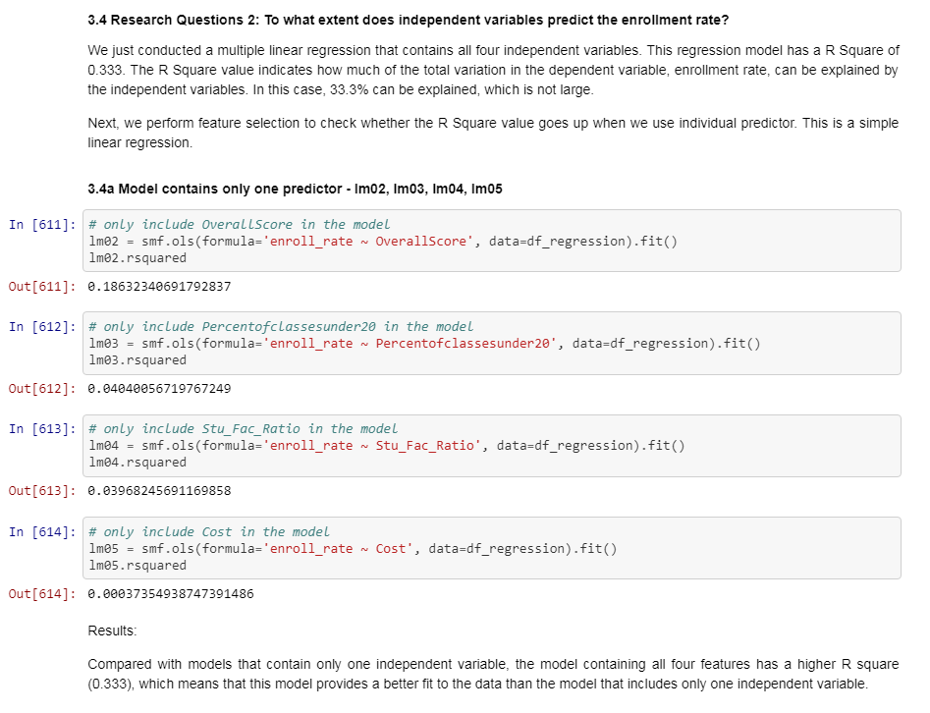

Slide 13
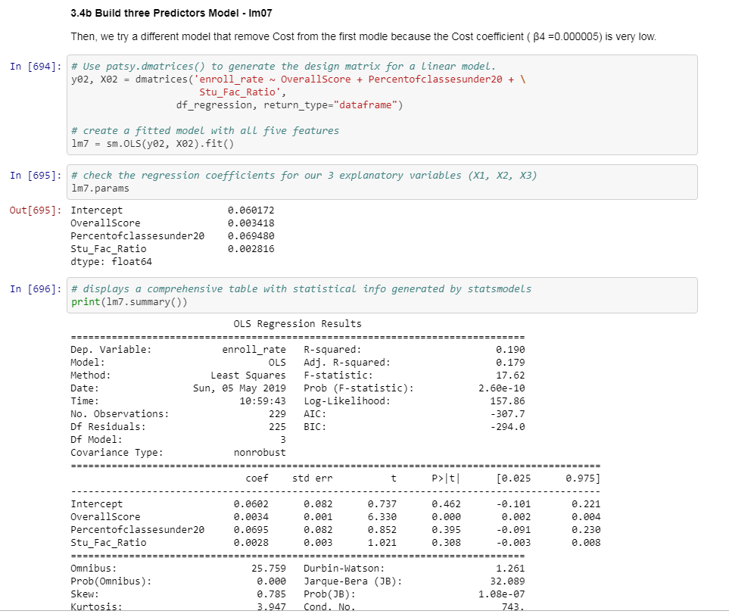

Slide 14
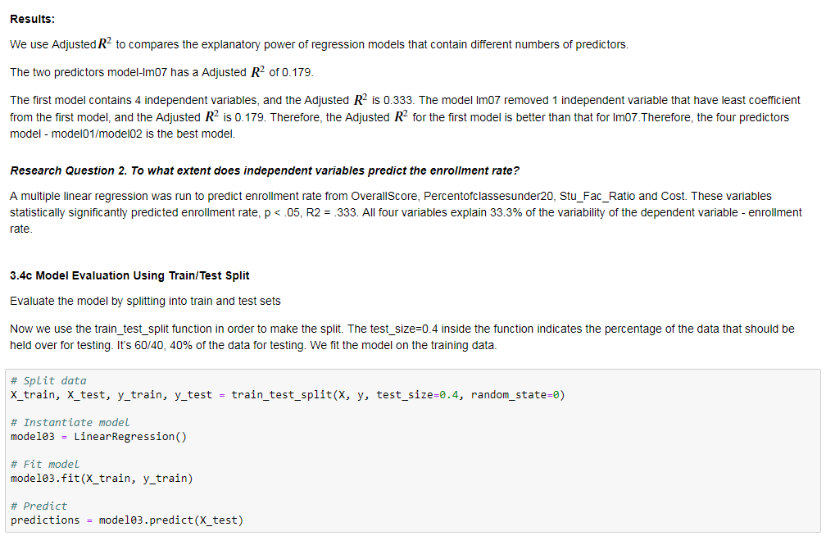

Slide 15
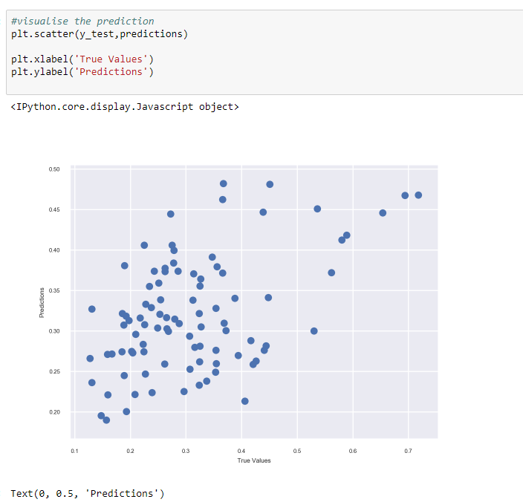

Slide 16
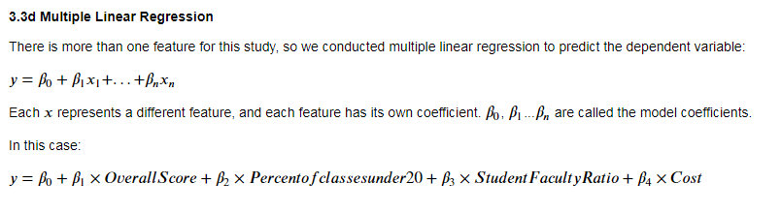

Slide 17
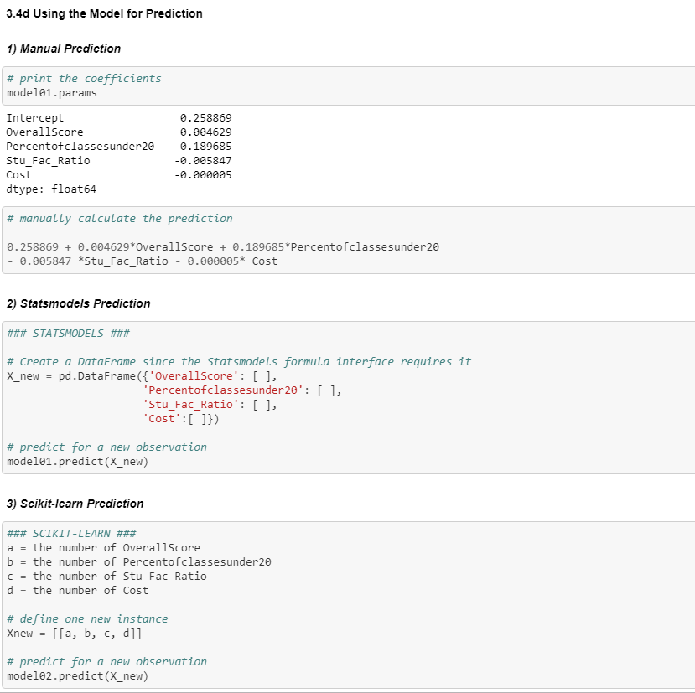

Slide 18
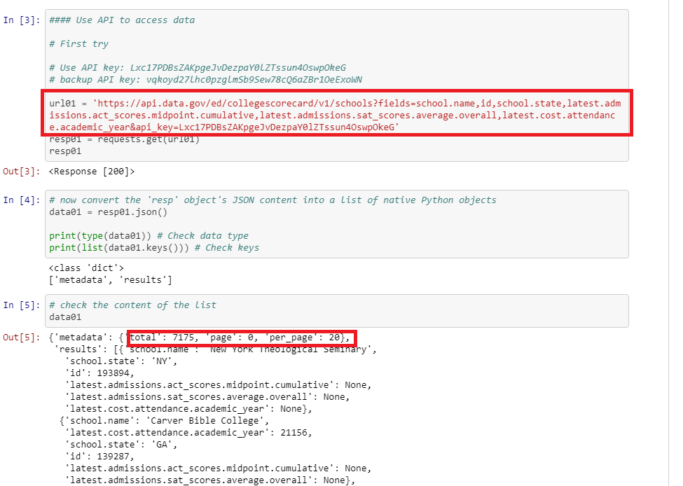
Challenge

Slide 19
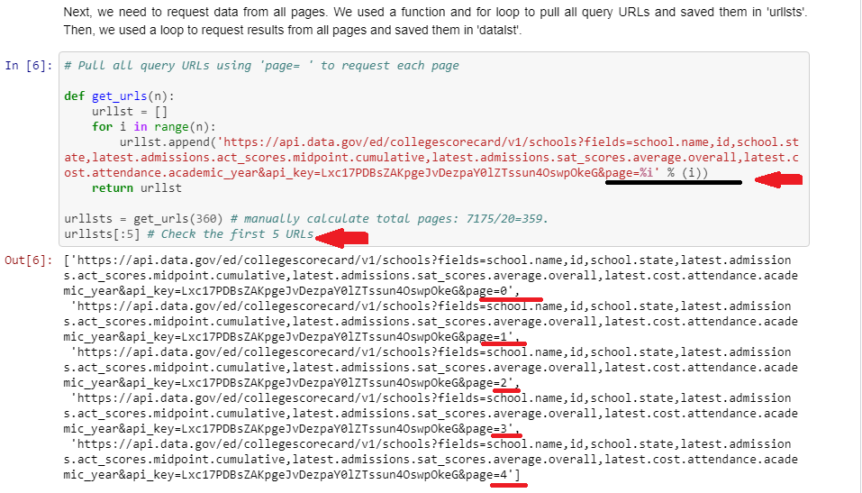

Slide 20
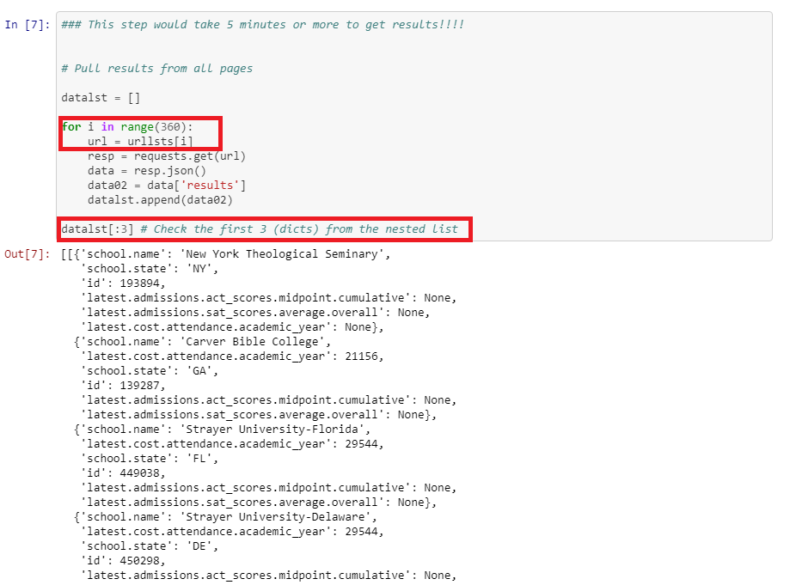

Slide 21
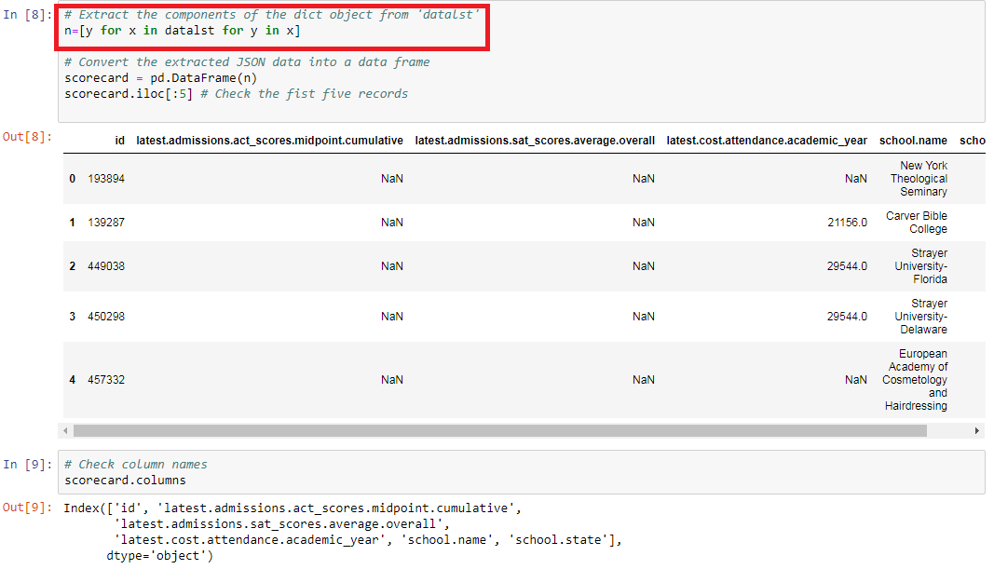

Slide 22
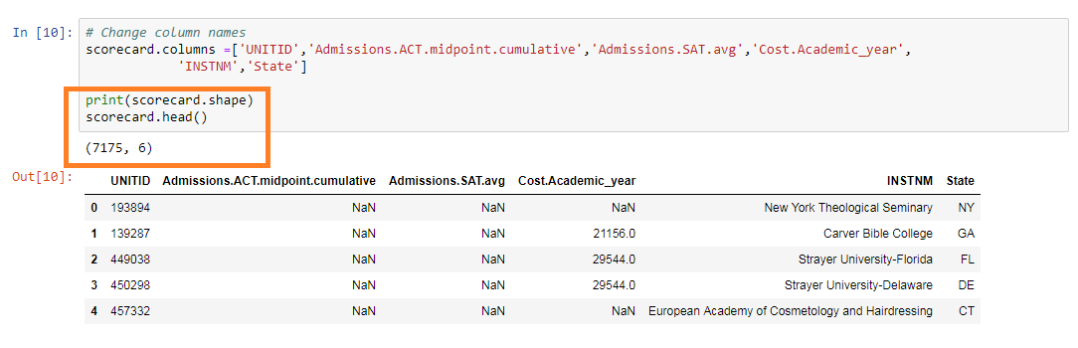

Slide 23
Student First-Year Retention Rate
Research question
Whose retention rate is better, private or public?
The impact of financial resources of schools and student cost.
Multiple linear regression.

Slide 24
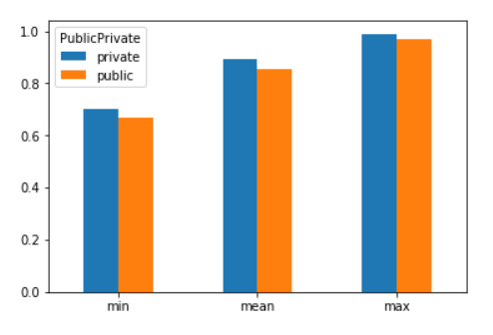
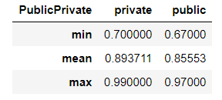
Student First-Year Retention Rate
Private or Public?
Private > Public
Notes:
The retention rate of private colleges is a little bit higher than public ones, no matter in minimum, mean, or maximum. But the difference between those is very small.

Slide 25
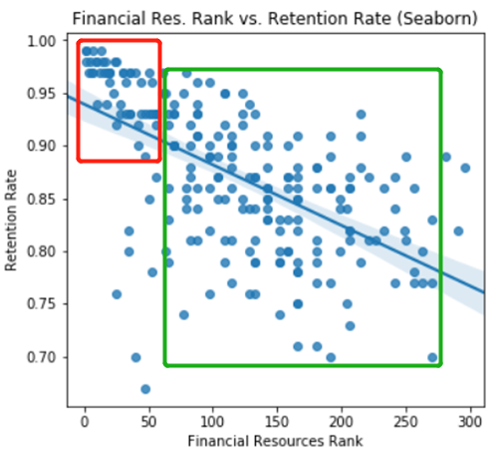
Student First-Year Retention Rate
Impact of financial resource

Slide 26
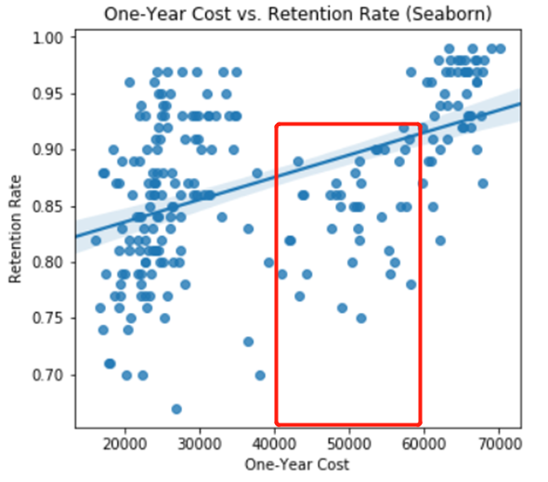
Student First-Year Retention Rate
Impact of student cost
Notes:
most people including me think that the academic year cost will bring economic pressure to the students and can decrease the retention rate.

Slide 27
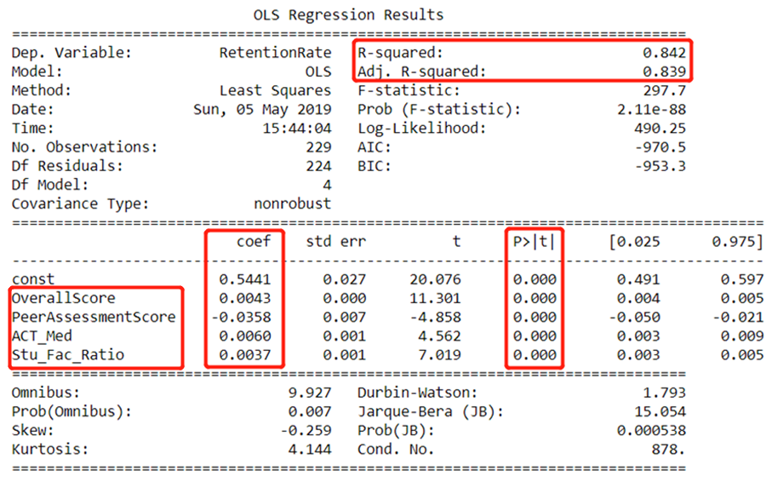
Student First-Year Retention Rate
Linear regression

Slide 28
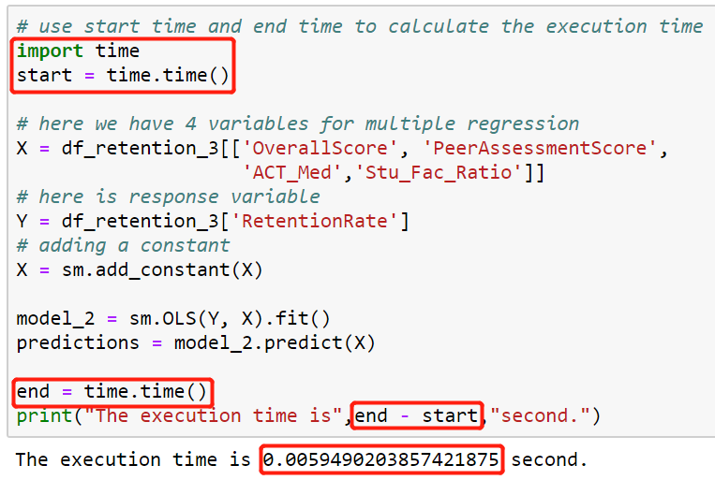
Student First-Year Retention Rate
Challenge

Slide 29
Graduation Rate
Questions :
1:Does university rank( or Overall Score ) affect graduation rate?
2:Is there a difference between graduation rates of public universities and the rates of private universities?
3:What is the relationship between student/faculty ratio and rank?
4:How does the school require SAT score for the graduation rate?
5:What is the impact of Cost on school graduation rates?
6: With the above analysis, can we predict the graduation rate of each school?

Slide 30
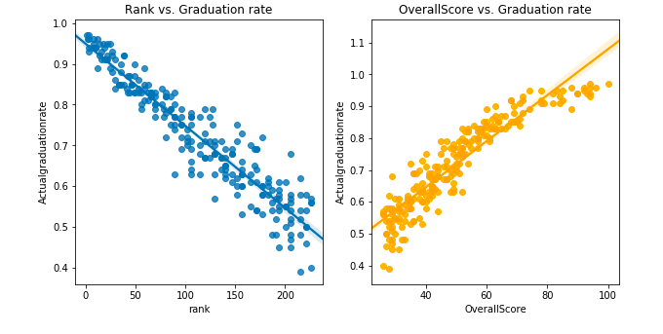
Question1: Does university rank( or Overall Score ) affect graduation rate?

Slide 31
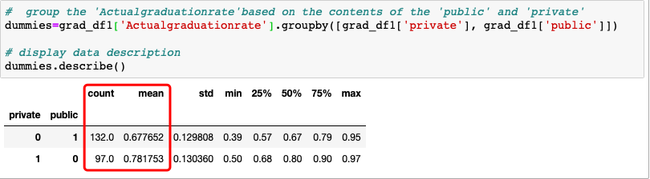
Question2: Is there a difference between graduation rates of public universities and the rates of private universities?

Slide 32
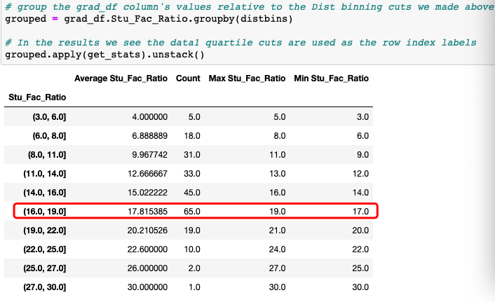
Questions 3: What is the relationship between student/faculty ratio and rank?

Slide 33
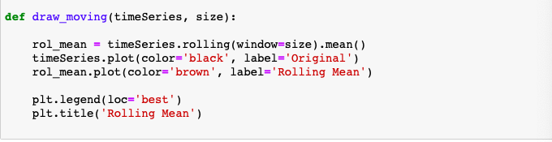
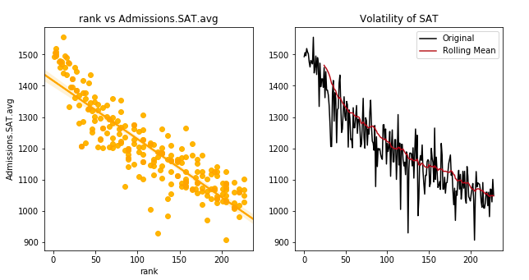
Question 4: Can the SAT be used as an indicator of the graduation rate?

Slide 34
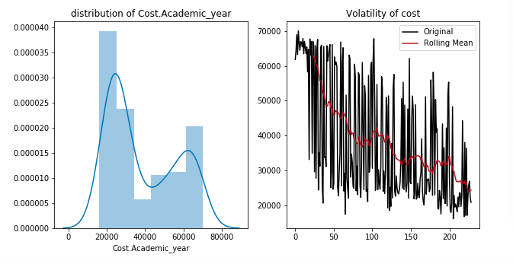
Question 5: What is the impact of Cost on school graduation rates?

Slide 35
Question 6: With the above analysis, can we do the best graduation rate regression of each school?
Multiple Linear Regression
Simple linear regression can easily be extended to include multiple features. This is called multiple linear regression: 𝑦=𝛽0+𝛽1𝑥1+...+𝛽𝑛𝑥𝑛y=β0+β1x1+...+βnxn Each 𝑥x represents a different feature, and each feature has its own coefficient.
In this case: 𝑦=𝛽0+𝛽1×𝑂𝑣𝑒𝑟𝑎𝑙𝑙𝑆𝑐𝑜𝑟𝑒+𝛽2×𝑙𝑜𝑔（𝐴𝑑𝑚𝑖𝑠𝑠𝑖𝑜𝑛𝑠.𝑆𝐴𝑇.𝑎𝑣𝑔）+𝛽3×𝑆𝑡𝑢𝐹𝑎𝑐𝑅𝑎𝑡𝑖𝑜+𝛽4×𝑝𝑟𝑖𝑣𝑎𝑡𝑒y=β0+β1×OverallScore+β2×log（Admissions.SAT.avg）+β3×StuFacRatio+β4×private

Slide 36
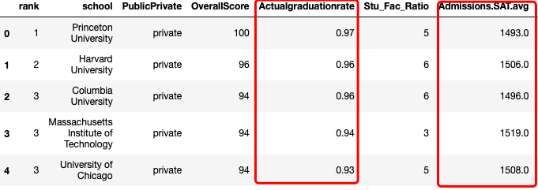
Challenge

Slide 37
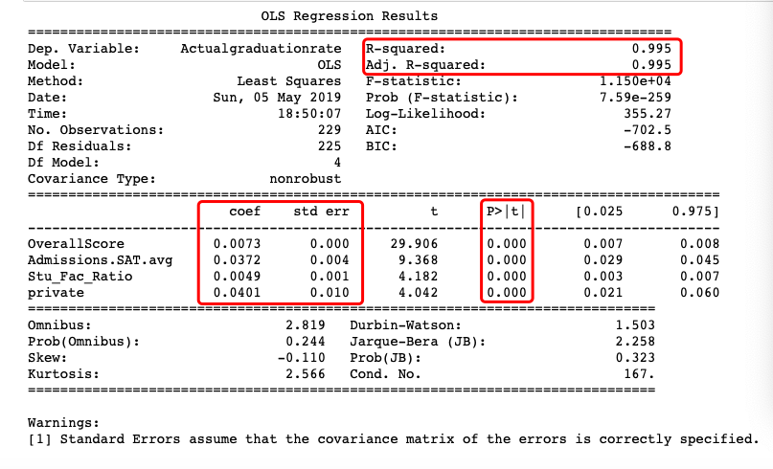
Question 6: With the above analysis, can we do the best graduation rate regression of each school?

Slide 38
Graduation rate Conclusion
From the above analysis, the better the school ranking, the higher the SAT score and the higher the student/faculty ratio, the higher the graduation rate; the opposite is also true. The graduation rate of private schools is also higher than that of public schools.
Because time and data are limited, we can not find all the factors that affect graduation rates. These factors are only a reference, but when choosing a school, if the graduation rate is used as a criterion for school selection, then the above factors should be carefully considered.

